Slide 1
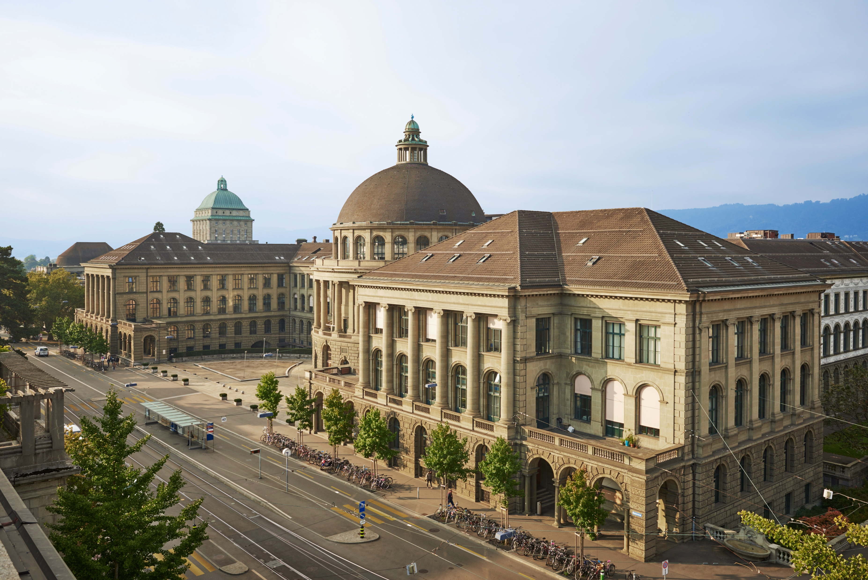
Building an RSE community in the ETH domain and steps towards a Swiss wide RSE community
Tarun Chadha and Uwe Schmitt
Scientific IT Services, ETH Zürich

Slide 2
A bit of history
What happened ?

Slide 3
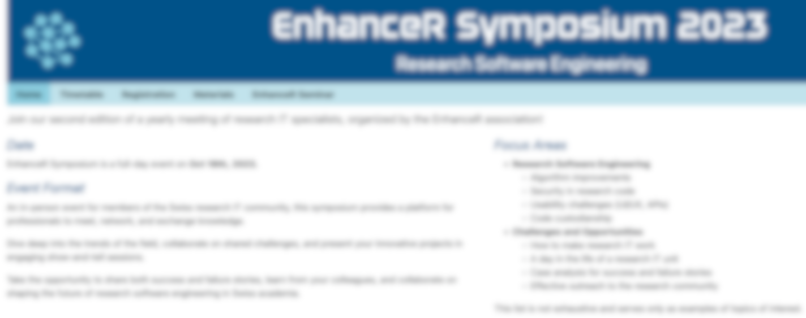
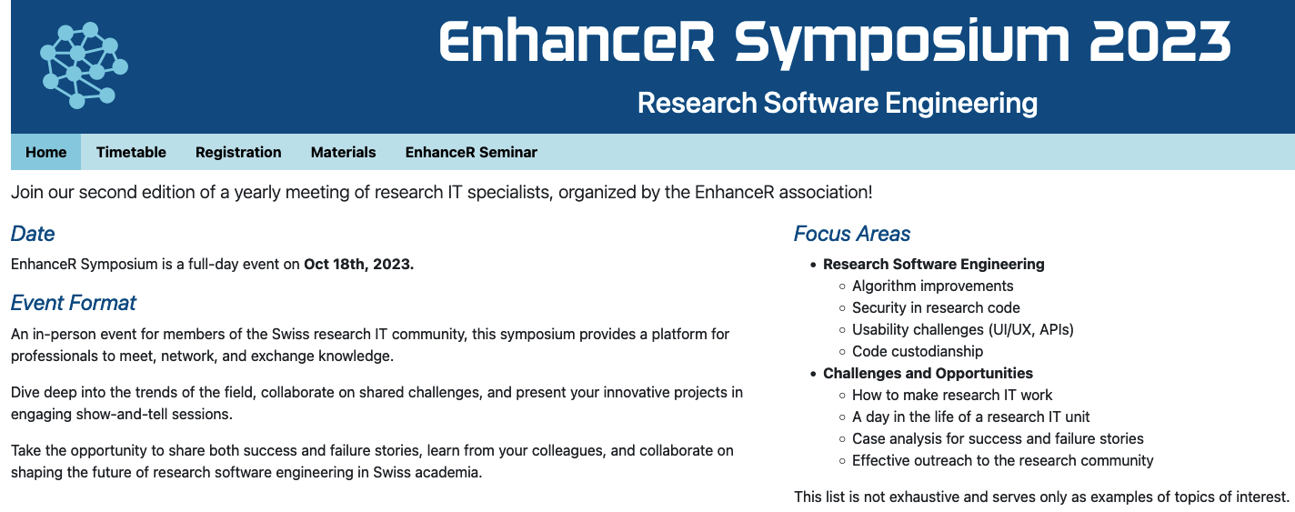

Source: https://www.enhancer.ch/

Slide 4
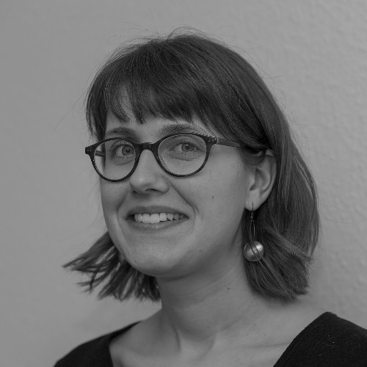
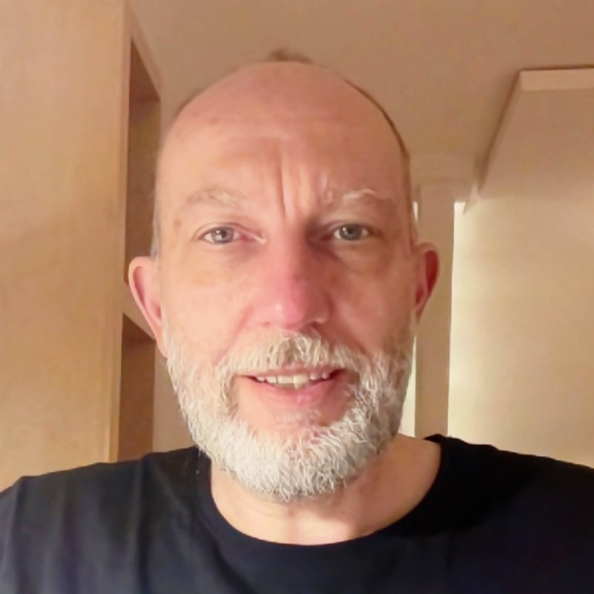
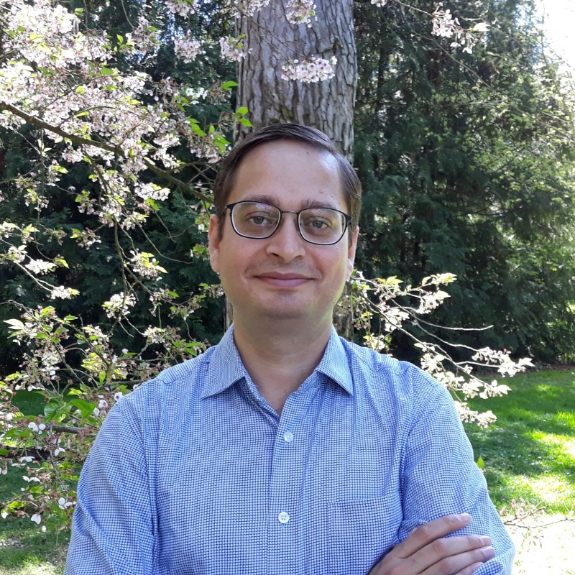
2022 - RSE Con UK Newcastle - Why don’t we have this in Switzerland?
September 2023 - RSE Con UK Swansea - Why don’t we have this in Switzerland?
October 2023 - EnhanceR symposium – Why don’t we have this in Switzerland?
If no one else is doing it, then why not us?

Slide 5
RSE community @ ETH: first steps
Mail campaign on the 23rd of November 2023
Emails to both research and technical staff
Incredible response
Announced 1st online information event on 12th of December 2023

Slide 6
1st online information event
Around 120 participants
2 parts:
Talk by Prof. Simon Hettrick (Software Sustainability Institute UK)
Information on community building @ ETH
RSE community survey
Q&A

Slide 7
Results of RSE community survey
13 out of 16 ETH Zurich departments represented!
Interest also from established technical staff!

Slide 8
First on-site event: 1st of February 2024
Part 1: Lightning talks
Part 2: Talk by Mr. Peter Schmidt
Part 3: Discussion rounds in small groups:
What do you expect from the RSE community?
What kind of role do you imagine for yourself in this community?
How can we build the community?

Slide 9
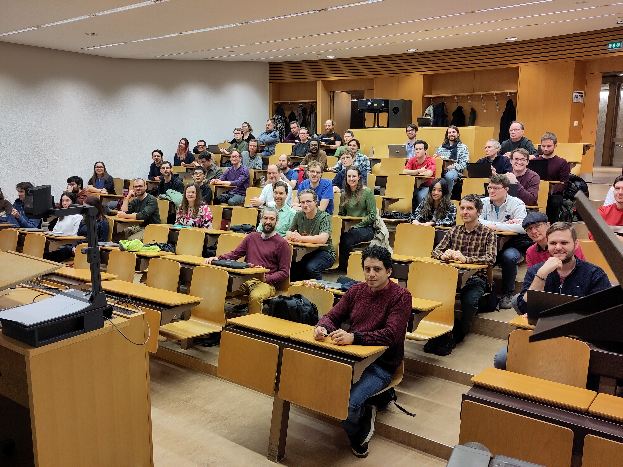

Slide 10
Reactions:
EPFL Lausanne: we also want to do something!
KOF Swiss Economic Institute: We were just about to set up something of our own!
280 members on mailing list
~80 on matrix chat
~65 at first on-site event

Slide 11
Ongoing activities

Slide 12
Focus
Establishing the community at ETH Zürich
Organizing regular events
Keeping the community engaged
Introducing the community at partner institutions (ETH Domain)

Slide 13
Community events
RSE Education
Lightning talks
Technical Talks/ exchange
RSE Jobs/Career

Slide 14
Community events
RSE Education
“Basics of computing environments for scientists” by IT Service group D-PHYS
Planning Git basics and advanced workshop with a colleague from CSCS (Swiss National Supercomputing Center)
Plans on starting a book club together with other RSE communities such as RSE Germany

Slide 15
Community events
Technical Talks/
Exchange
Group discussions about “automated testing”
Presentations about “devbox” and “pytest-regtest”
Scientific and Technical Publishing with “Quarto” – from reports to books and ebsites
Upcoming event: “Show your tools”: 5th December

Slide 16
Community events
RSE Jobs/Career
Applying for RSE Jobs: Panel discussion

Slide 17
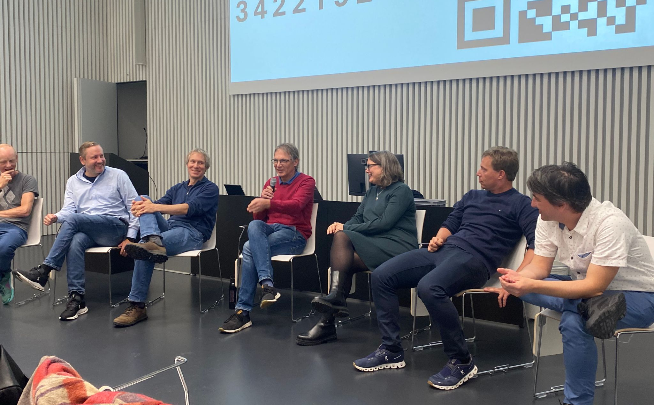

Slide 18
Community events
RSE Jobs/Career
Applying for RSE Jobs: Panel discussion
Community contributed blog article on lessons learned

Slide 19
Community communication
Regular exchange: Matrix space for chat
Announcements: Mailing list
Website: https://rse.ethz.ch

Slide 20
Working Group
Contributors from the community:
Roman Wixinger
Jaime Cardozo
Franziska Menti
Marco Gähler
Work on:
Website
Events
Survey
…

Slide 21
International Visibility
Presentations about current activities at deRSE in Würzburg March 2024
Short presentation and workshop “international RSE communities”, RSECon24 Newcastle, September 2024
Coauthoring Reseach Software Alliance (RESA) blog post: https://www.researchsoft.org/blog/2024-09-24/
Planned:
deRSE25 Karlsruhe, February 2025
RSECon25 Warwick, September 2025

Slide 22
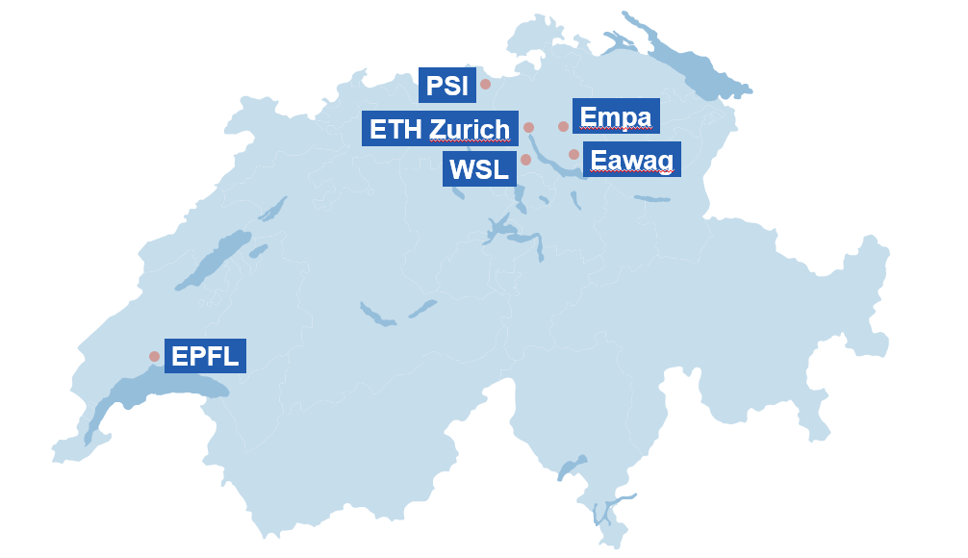
ETH Domain

Slide 23
RSE@ETH Domain
We, together with the partner institutions in the ETH domain, submitted a proposal for funding to ORD measure 2, which was accepted
RSE4ORD: building a research software engineering community to promote open science

Slide 24
Future activities

Slide 25
RSE4ORD:
Project started October 2024: 0.75 FTE/year for 2 years
Kicking-off RSE communities at partner institutions: RSE@ETH will help get started
Promoting FAIR (Findable, Accessible, Interoperable, Reusable) for research software
Guidelines for RSE

Slide 26

Swiss RSE event
Source: Wikimedia.org (CC BY-SA 3.0 Deed)

Slide 27
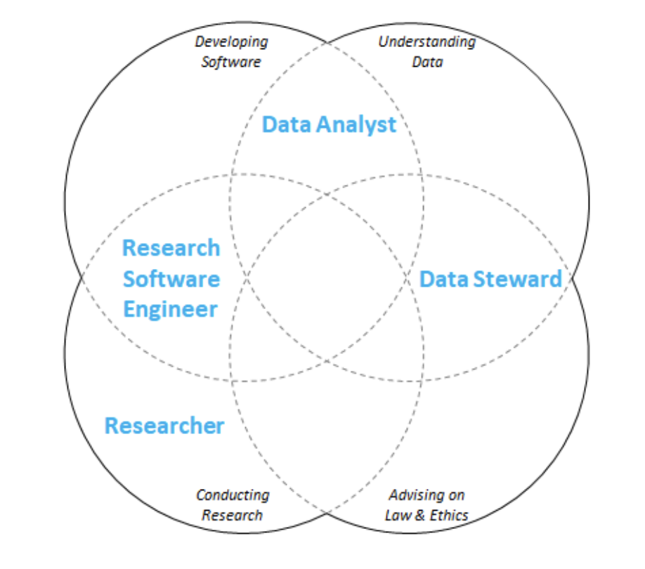
Synergies/overlaps:
Reproducibility network
Building digital workforce capacity and skills for data-intensive science (2020). In OECD Science, Technology and Industry Policy Papers.

Slide 28
EnhanceR and RSE
How can these communities support each other?
Can EnhanceR play a role in bringing RSE beyond the ETH domain?
...

Slide 29
Contact: Tarun Chadha, tarun.chadha@id.ethz.ch Uwe Schmitt, uwe.schmitt@id.ethz.ch www.rse.ethz.ch Licence for using/sharing: CC-BY-NC-4

